Slide 1
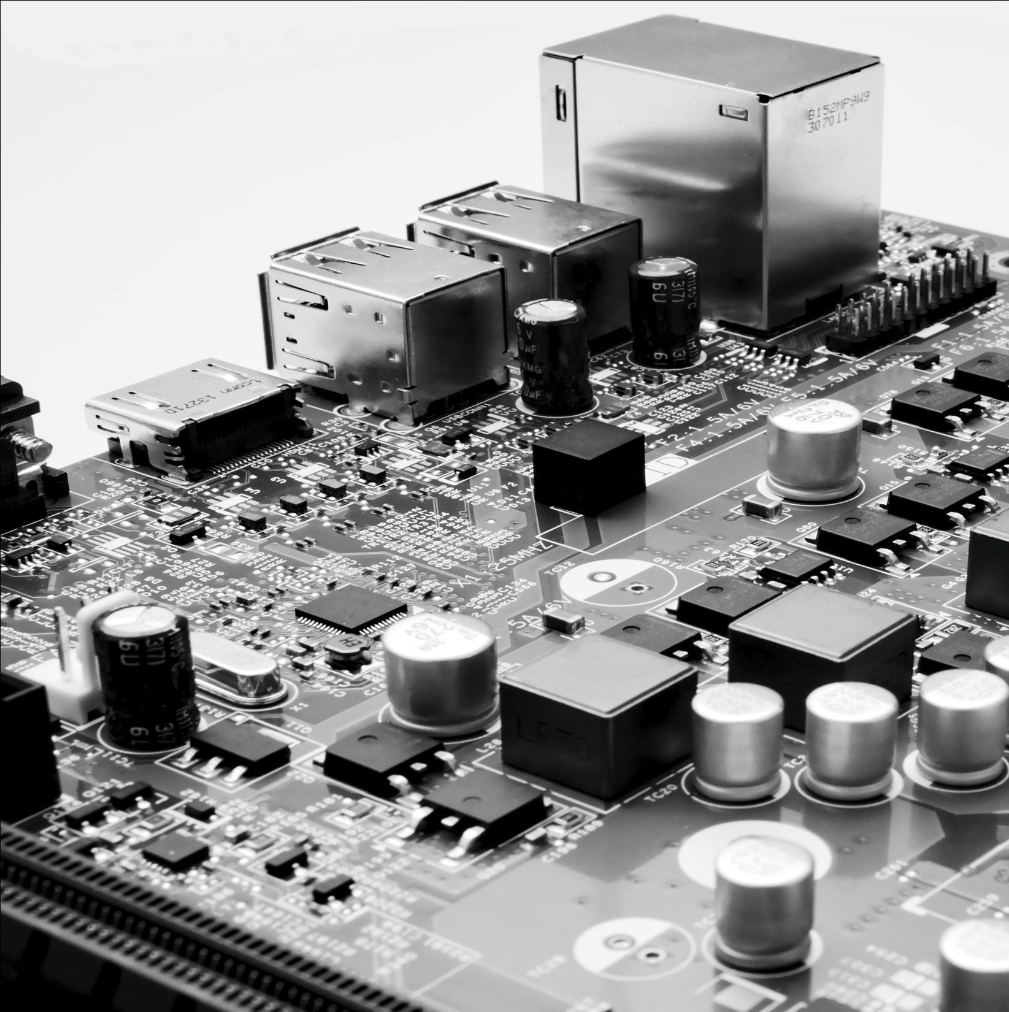






INTRODUCTION: MASS FACE MASK DETECTION PROJECT USING KERAS, TENSORFLOW AND MOBILENET
In this ongoing era of pandemic, wearing a “Face Mask” is the need of the hour as it is a proven medical equipment to resist the spread of SARS-CoV-2 Virus, also known as Coronavirus, through human interaction. But despite of the COVID norms, many people are still loitering around without wearing a face mask properly. It is an absolute necessity to track those people as they are the most potential super-spreaders of COVID-19. To resolve this issue, we have come up with an innovative yet cost-effective module for "Mass Face Mask Detection" using the principles of Computer Vision. To build this project, we have used packages like Tensorflow, Keras, OpenCV, matplotlib, Mobilenet V2 and streaming modules like Ffmpeg to implement our project and to make it capable enough to detect masked or without-masked persons from livestreams. The detailed Methodology and the prospects of the project is discussed in the next two sildes.
MENTOR
Rohan Das, 3rd Yr(IT), IEM
Swapnamoy Das, 3rd Yr(IT), IEM
Jay Prakash Pandey, 3rd Yr(IT), IEM
Abhishek Anand, 3rd Yr(IT), IEM
Prof. Mrs. Kajari Sur, Dept. of Information Technology, IEM
1

Slide 2



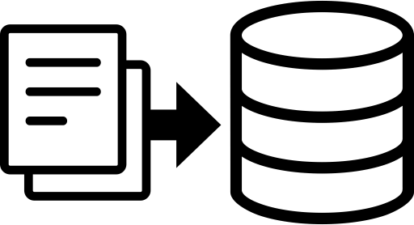
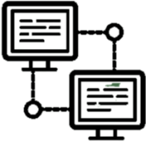
METHODOLOGY(Flowchart of the Algorithm)
Append Image Arrays
20% Image for Test
80% Image for Training
Input Image
Convolution
Max Pooling
Fully Connected
Output
Base Model
Read Model
Pre-Trained Weight
Using MobileNet
METHODOLOGY Through the IDEAS (Steps involved in the Process)
Detection of Mask or Without Mask
Give Output in a Frame
2
4
1
3
5
Decision Making
Accessibility
Read Image and decide whether the person is with or without face mask using the algorithm.
Upload the Fetched Data into the Clouds to Ensure Easy Accessibility while working with it.
Sharing the Data
Image Detection
Encapsulation
of the Data
Publishing the Information about the % of people wearing mask or not in a particular area through app or website.
At First, The Trained Model detects Human Faces from a Live Video
Collect the Cumulative Data of the People both with or without Face Mask

Slide 3

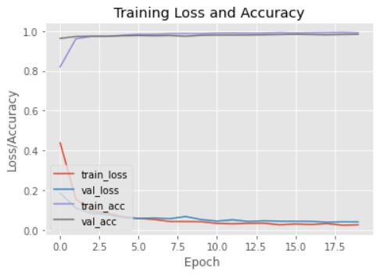
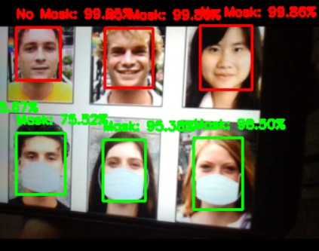
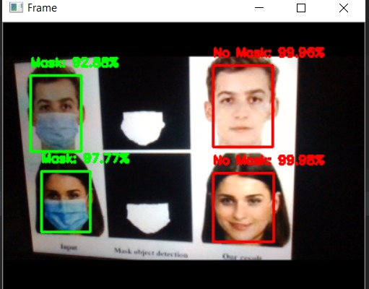
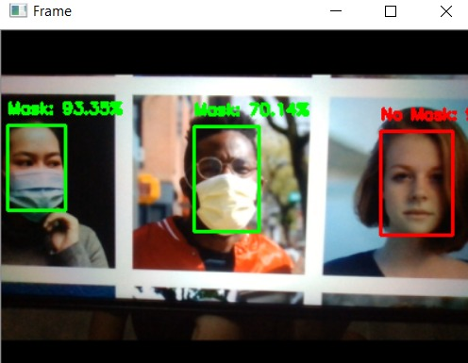
WHY OUR PROJECT?
BECAUSE WE “CARE”
Curbing the Spread of Covid
C
A
R
E
Using the previously mentioned methods, we can successfully track the number of masked and non-masked people in a certain area. Thus, this project directly helps to curb the spread of covid by tracking the without masked ones and imposing a penalty upon them.
Ability to detect from livestreams
Other projects are based on the theme of " Face Mask Detection" have been primarily built on the basis of "1:1 detection". But our model will be able to detect status of face mask from multiple people's image consisting in a single frame. It will be also able to track down the face mask status from a live-streaming camera like CCTV, thus ensuring that covid norms are properly followed in a larger locality.
Few Screenshots related to the Efficiency and Performance of Our Project
Regular data uploading
Our website and application will consistently upload the real time data and percentage of masked and without masked persons, so that anyone can check whether a particular place is safe to visit or not and can plan accordingly.
Efficient and Cost-Effective
This Project would also help the administration to ease the hectic process of tracking each and every mask-less person manually. Thus, in terms of efficiency and cost-effectiveness, this project is surely going to help the majority chunk of masses in various ways.

